Slide 1

Cheating Depth: Enhancing 3D Surface Anomaly Detection via Depth
Paper review
Gibeom Kim (UST)

Slide 2

Index
Paper abstract
Model
Conclusion

Slide 3
1. Paper abstract
Limitations of RGB and the need for 3D information
Designed to learn a discrete latent representation space that can simultaneously model RGB and depth data
Based on the learned DADA, a novel 3D anomaly detection method is proposed to effectively detect anomalous surfaces

Slide 4
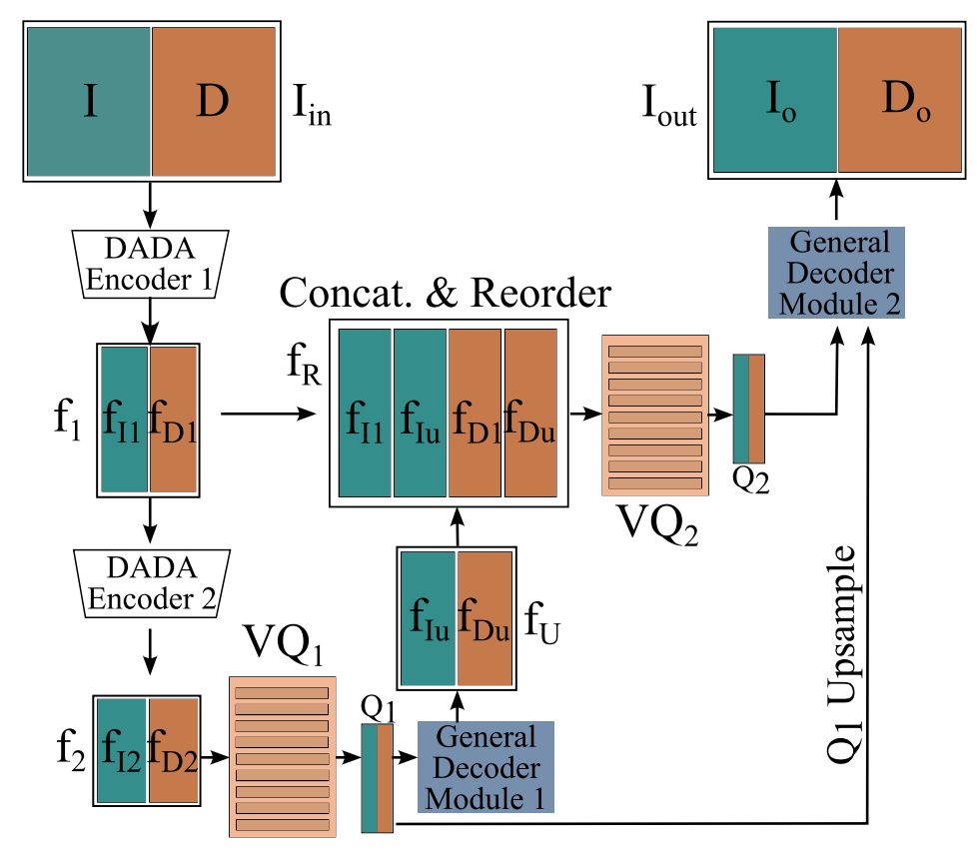
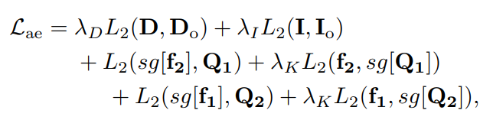
2. Model
Depth-aware discrete Autoencoder (DADA)
Based on VQ-VAE2 model, but not using RGB-D data
This model use 3 channel image data, and 3 channel depth data
Local gradient of depth data is not large
Apply grouped convolution layers
Notes:
보통의 VQ-VAE(4채널 입력)로 RGB+Depth를 학습할 경우, L2 재구성 오차에 더 크게 기여하는 RGB 채널이 모델의 학습을 지배해 버립니다.
Depth는 값의 변화 폭이 작고, 상대적으로 로컬 그라디언트가 약해 L2 손실에 크게 반영되지 않아, 모델이 Depth 정보 학습에 소홀해질 위험이 큽니다.

Slide 5
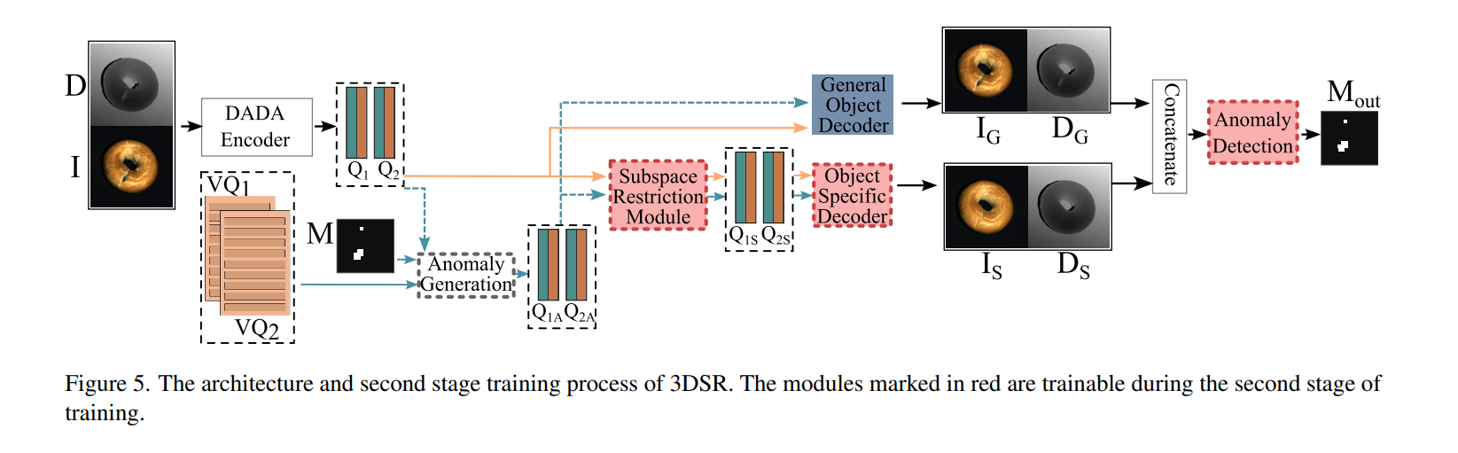
2. Model

Slide 6
2. Model
Using pretrained DADA model
Get Quantized feature vector(Q1, Q2)
Replace random location of vector Q1, Q2 based on random Mask M
Replaced data is based on VQ1, VQ2
Simulated feature-level anomalies injected feature Q1A, Q2A

Slide 7
2. Model
Based on Q1A, and Q2A, Subspace Restriction Module is trained
This module use L1 loss for eliminate anomalies and re-project to normal feature
During this step, module tries to reconstruct to normal feature

Slide 8
2. Model
General Object Decoder
Reconstruct based Q1A, Q2A, generate abnormal image
Object Specific Decoder
Reconstruct based Q1S, Q2S, generate normal image

Slide 9
2. Model
After concat IG, DG, IS, DS, input the data to Anomaly detection module
Use Focal loss to generate segment image, Mout directly

Slide 10
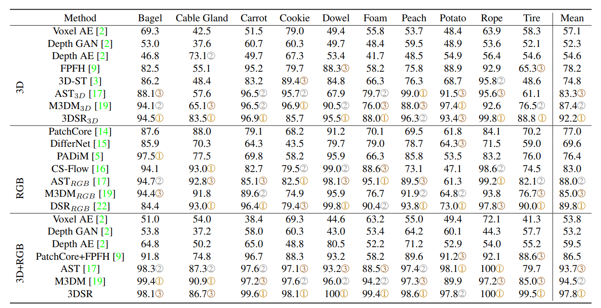
3. Conclusion

Slide 11
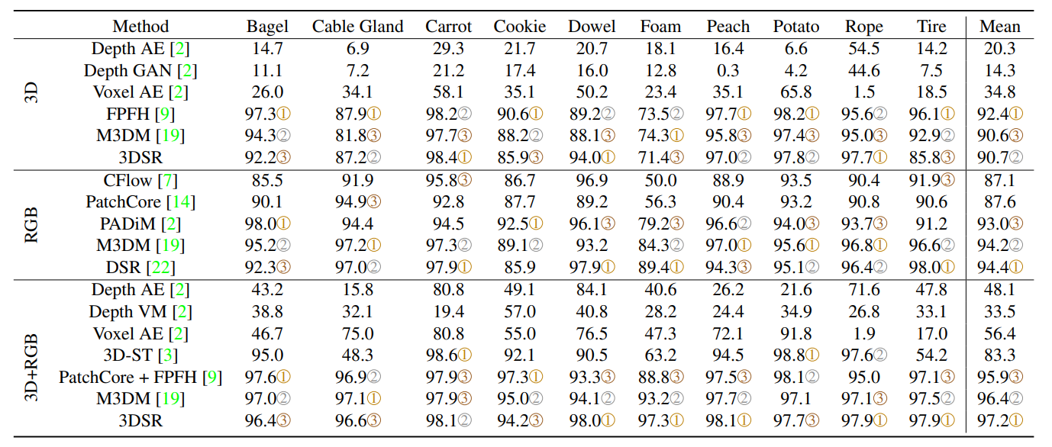
3. Conclusion

Slide 12
Thank you

